Slide 1
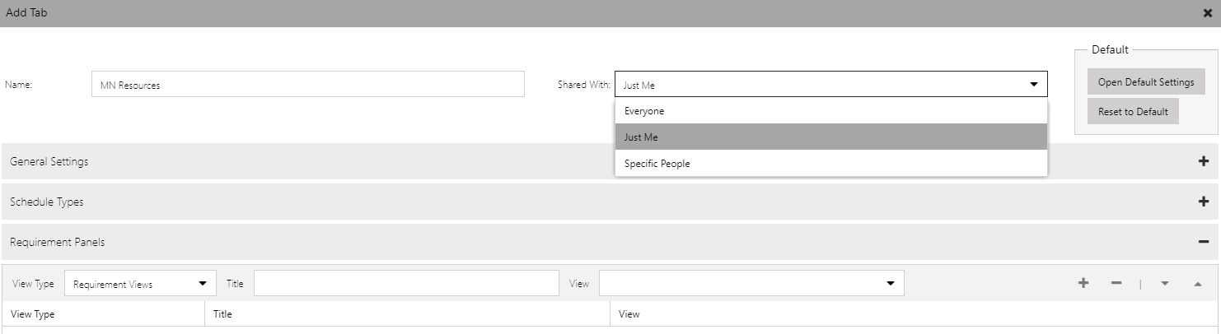
The name that will be displayed on the Schedule Board.
Specifies who the schedule board tab will be visible to. Just Me is the default. Choosing Specific People will require additional configuration.
Lets you reset the Schedule Board tab to the default settings. The default settings that will be applied to all new boards can be modified.

Slide 2
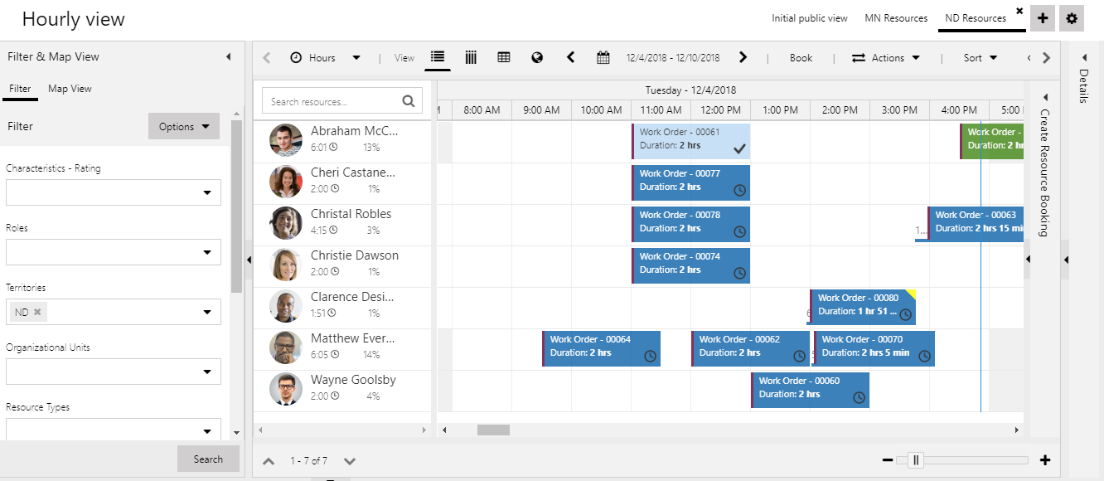
Additional boards can be defined for easier dispatching of resources.
The default filter for the Schedule Board can be defined using the options button.
Add Tab button lets you add additional Schedule Board tabs.

Slide 3
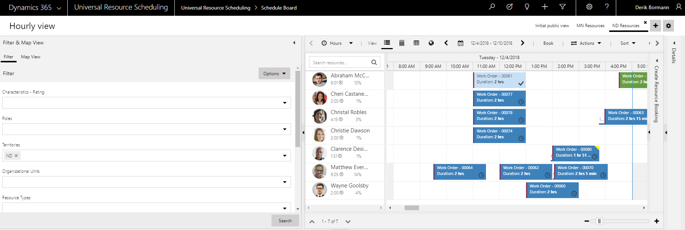
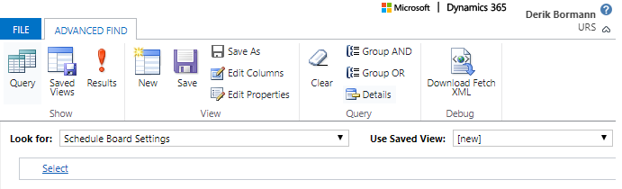
Use Advanced find to locate the schedule board to share.
Click results to view all the Schedule Board Settings records.
Select the Schedule Board Settings Entity.

Slide 4
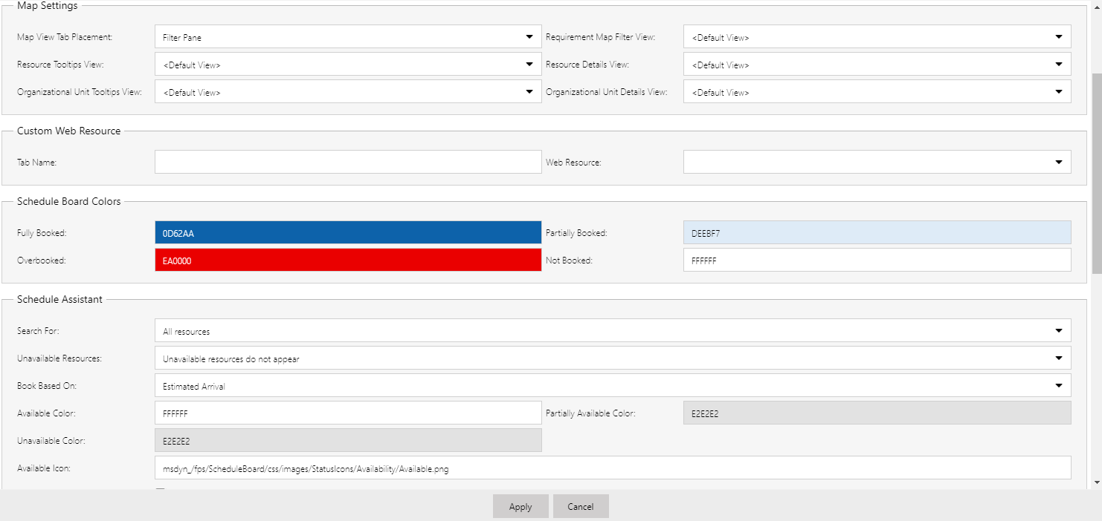
Lets you specify the location of the Map view on the board
Dynamics 365 views can be created or modified to help filter and display data for the Map view.
All settings defined including Map view, custom web resource, Schedule Board colors, and Schedule Assistant settings are only specific to selected Schedule Board tab.

Slide 5
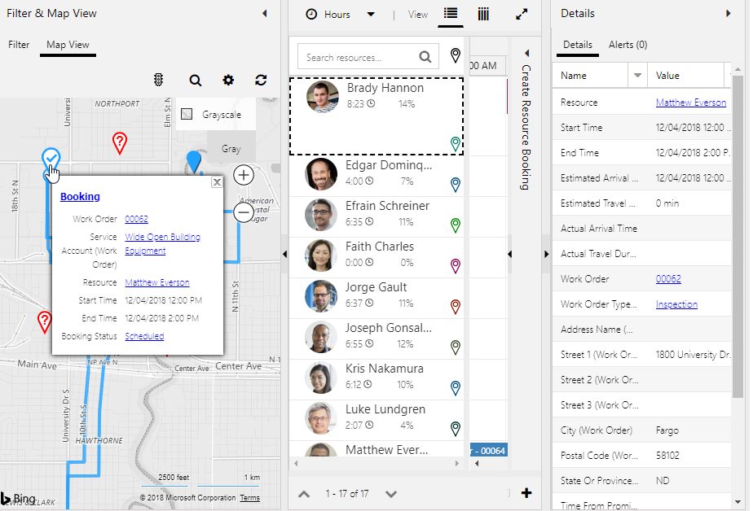
A view called Resource Booking Map Tooltips provides booking details when users hover over a booking.
The default view named Active Bookable Resource Bookings provides booking details when a booking is selected.

Slide 6
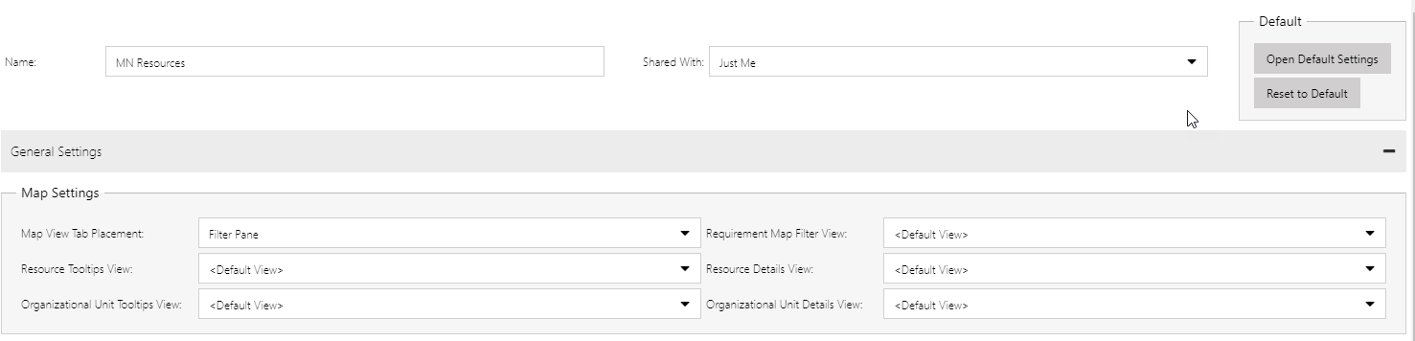
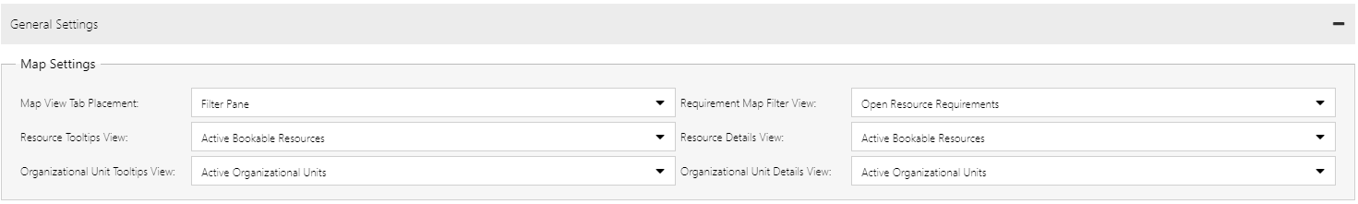
Unless the view is changed, view fields will display <Default View>. You can see all the defined default views by selecting the Open Default Settings button.
Changing the views in the default settings will affect any item that is using the default view, and any new schedule board tabs created.

Slide 8
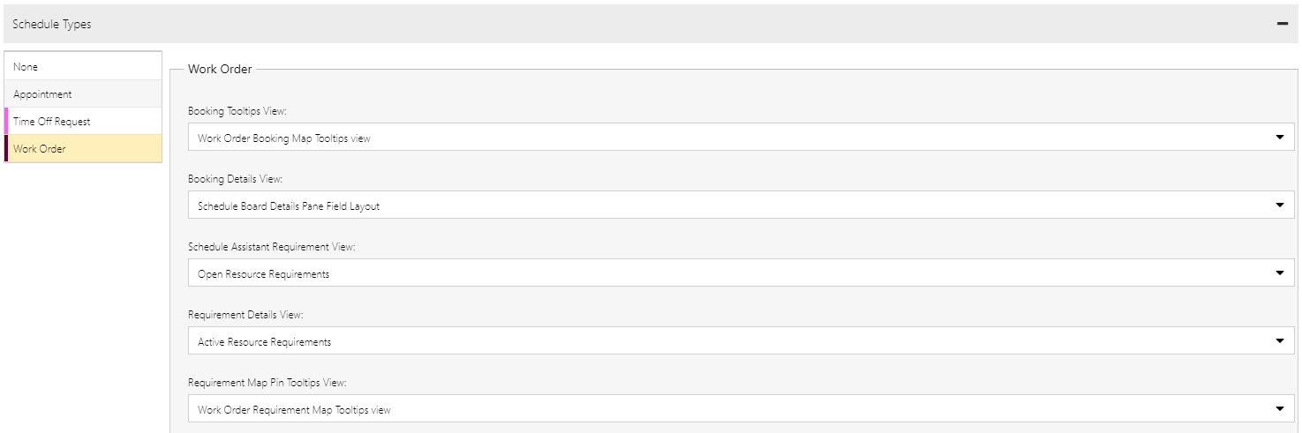
Select the entity to see the views being used.

Slide 9
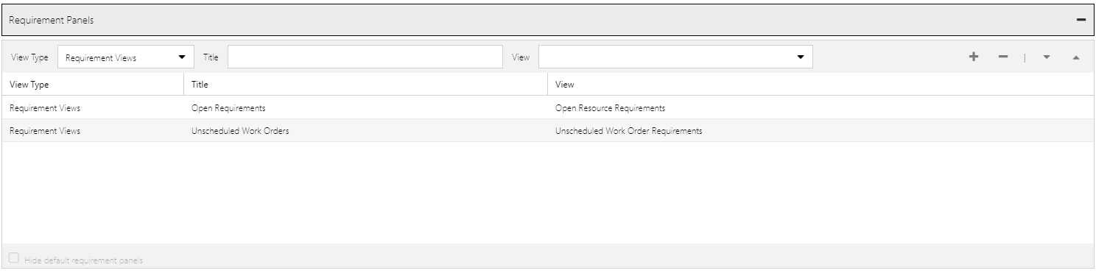
New tabs can be added to the requirements panel by selecting a view type, providing a title, selecting the view to use, and clicking the add button.

Slide 10
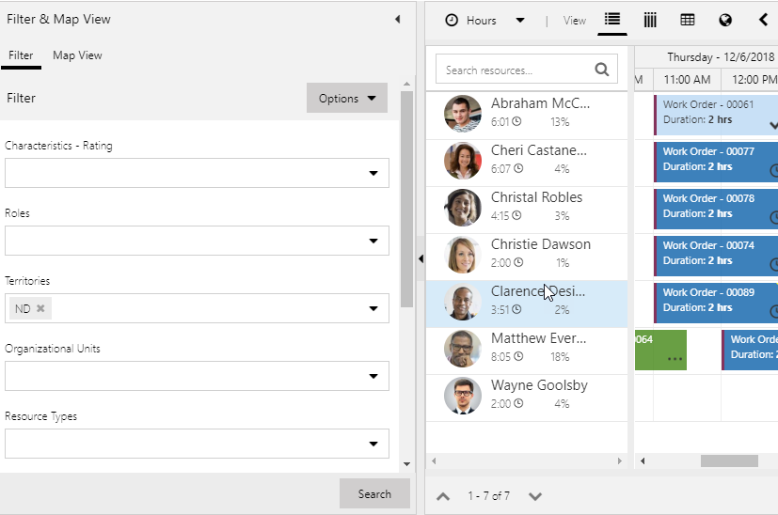
Filter Layout Query defines the controls available to be used as filters.
Resource Cell Template defines the data displayed in the cell.
Retrieve Resource Query controls results returned when the Search button is clicked.

Slide 11
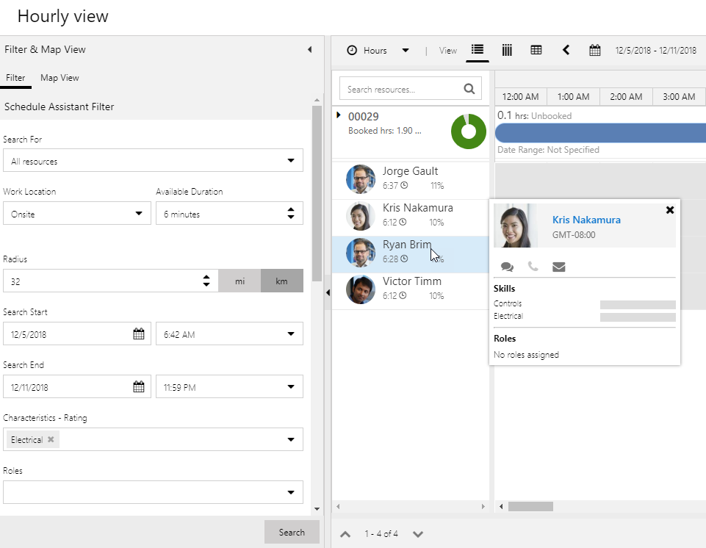
Schedule Assistant Filter Layout defines the filter controls available.
Schedule Assistant Resource Cell Template defines the data displayed on the resource cell.
Retrieve Constraints pulls constraint values from the resource requirement record and populates them to the appropriate filter controls.
Schedule Assistant Retrieve Resource Query controls results returned when the Search button is clicked.

Slide 12
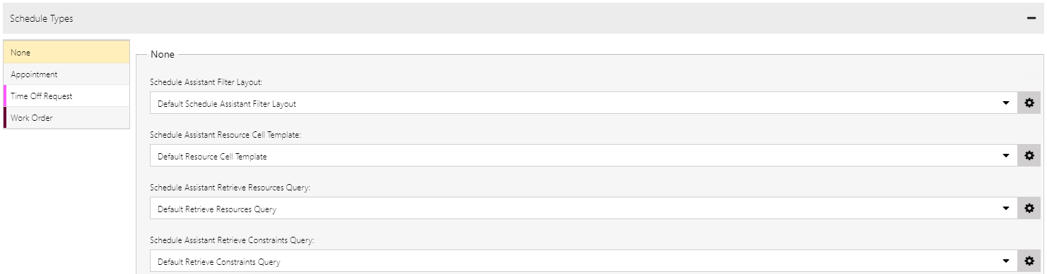
Select the entity you want to modify schedule assistant queries for.

Slide 13
Lets you see and define default settings for boards. Views defined in the default settings will be applied any time default view is selected.

Slide 14
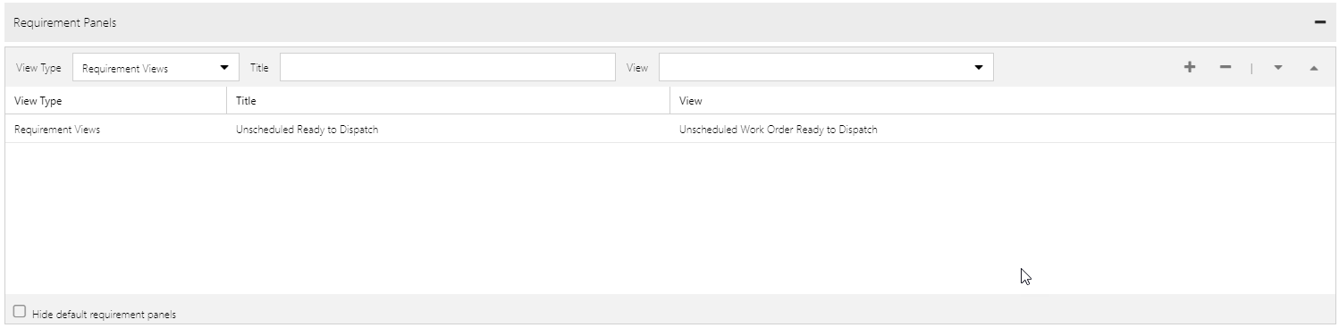

Slide 15
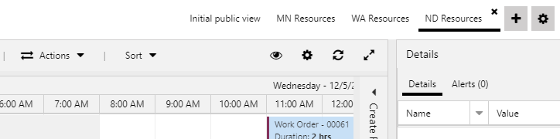
Opens the tab settings for the currently selected schedule board

Slide 16
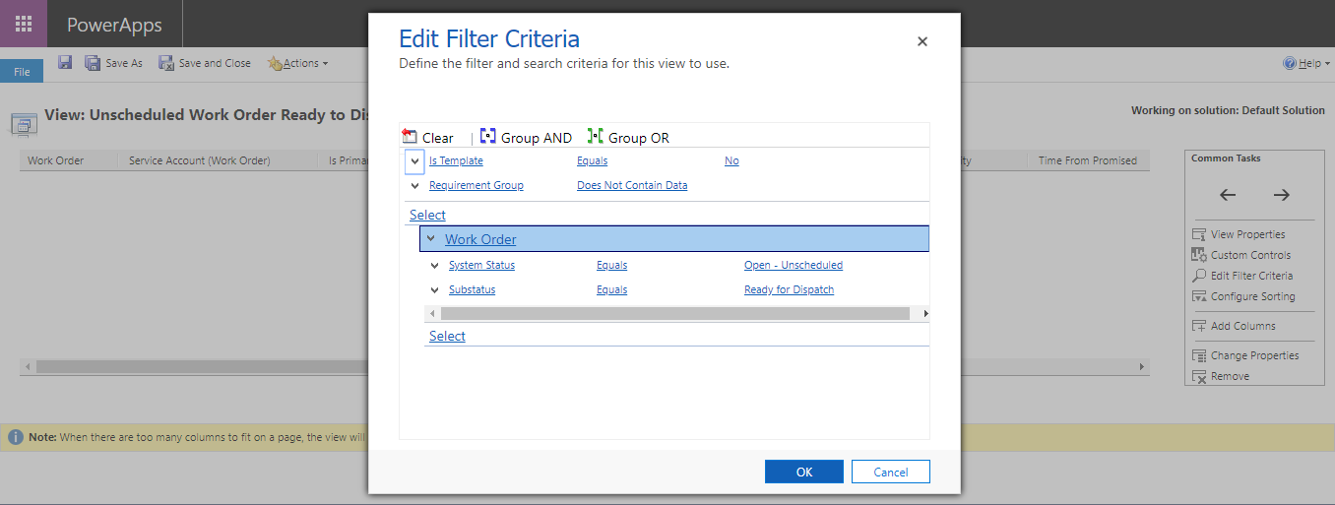
Resource Requirement Entity view is being filtered based on the System Status and Sub-status fields on the related work order.

Slide 17
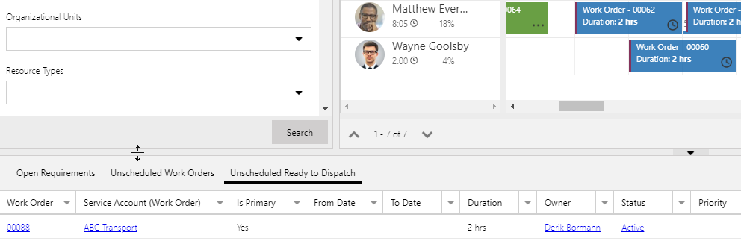
View added as new a requirements panel tab

